Slide 1
Rayat Shikshan Sanstha’s Arts, Science & Commerce College, Mokhada Dist. : Palghar
Class : T.Y.B.Sc. Semester : V
Prepared by :- Mr. Patil Prashant K.

Slide 2
MULTIPLE INTEGRALS

Slide 3
INTRODUCTION
In this chapter, we extend the idea of a definite integral to double and triple integrals of functions of two or three variables.
These ideas are then used to compute volumes, masses of more general regions.

Slide 4
We will see that polar coordinates are useful in computing double integrals over some types of regions.
Similarly, we will introduce two coordinate systems in three-dimensional space that will simplify computing of triple integrals over certain commonly occurring solid regions.
Cylindrical coordinates
Spherical coordinates

Slide 5
DEFINITE INTEGRAL—REVIEW
First, let’s recall the basic facts concerning definite integrals of functions of a single variable.

Slide 6
If f(x) is defined for a ≤ x ≤ b, we start by dividing the interval [a, b] into n subintervals [x_{i–1}, x_{i}] of equal width ∆x = (b – a)/n.
We choose sample points x_{i}* in these subintervals.

Slide 7
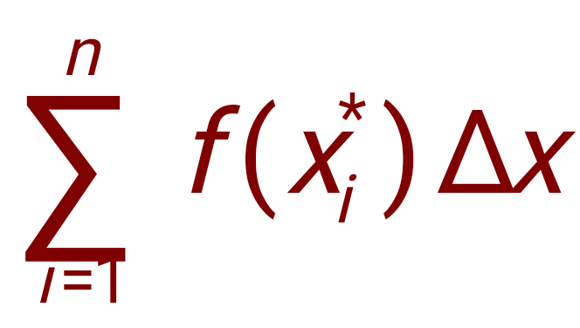
Then, we form the Riemann sum
Then, we take the limit of such sums as n → ∞ to obtain the definite integral of f from a to b:

Slide 8
In the special case where f(x) ≥ 0, the Riemann sum can be interpreted as the sum of the areas of the approximating rectangles.

Slide 9
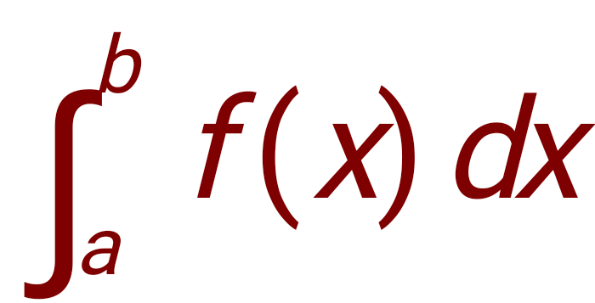
Then, represents the area under the curve y = f(x) from a to b.

Slide 10
Double Integrals over Rectangles
In this section, we will learn about:
Double integrals and using them
to find volumes.

Slide 11
As we attempt to solve the area problem, it led to the definition of a definite integral. Likewise, we now seek to find the volume of a solid.
In the process, we arrive at the definition of a double integral.

Slide 12
Double Integrals over Rectangles
Rectangle
Definition:
Let R = {(x, y) ∈ℝ² / a ≤ x ≤ b, c ≤ y ≤ d} = [a, b] x [c, d]
x = a and x = b , y = c and y = d
Y
y = d
y = c
x = a
x = b
X

Slide 13
Partition of a Rectangle:
Let P₁ = {a = x₀, x₁, ……, x_{n} = b} be a partition of [a, b] and
P₂ = {c = y₀, y₁, ……, y_{t} = d} be a partition of [c, d].
Let P = P₁ x P₂ = { (x_{i}, y_{j}) / 1 ≤ i ≤ n and 1 ≤ j ≤ t }, then P is called a Partition of the rectangle R.
This Partition divides the rectangle R into ‘nt’ subrectangles
R_{ij} = [x_{i-1}, x_{i}] x [y_{j-1}, y_{j}]
= { (x, y) / x_{i-1},≤ x ≤ x_{i} , y_{j-1}≤ y ≤ y_{j} } where 1≤ i ≤ n, 1≤ j ≤ t
Y
y = d
y_{t}
y = c
y₂
y₁
x₀
x₁
x₂
x_{n}
x = a
x = b
X

Slide 14
Upper and Lower Riemann Sum
Definition :
Let f : [a, b]x[c, d]→ℝ be a bounded function of two variables x and y defined over the rectangle [a, b]x[c, d].
Let P = P₁ x P₂ where P₁ = {a = x₀, x₁, ……, x_{n} = b}
P₂ = {c = y₀, y₁, ……, y_{t} = d} dividing [a, b] x [c, d] into nt subrectangles R_{ij} = [x_{i-1}, x_{i}] x [y_{j-1}, y_{j}] for i = 1, 2, …., n, and j = 1, 2, …., t
Let m_{ij} = $\inf_{(x, y)∈R_{ij}}{f(x, y)}$ M_{ij} = $\sup_{(x, y)∈R_{ij}}{f(x, y)}$
for i = 1, 2, …., n, and j = 1, 2, …., t
Let ∆R_{ij} = Area of Rectangle R_{ij}
= (x_{i} - x_{i-1})(y_{j} - y_{j-1})
Let L(P, f) = $\sum_{i=1}^{n}{\sum_{j=1}^{t}{m_{ij}∆R_{ij}}}$ = $\sum_{i=1}^{n}{\sum_{j=1}^{t}{m_{ij}}}$(x_{i} - x_{i-1})(y_{j} - y_{j-1})
U(P, f) = $\sum_{i=1}^{n}{\sum_{j=1}^{t}{M_{ij}∆R_{ij}}}$ = $\sum_{i=1}^{n}{\sum_{j=1}^{t}{M_{ij}}}$(x_{i} - x_{i-1})(y_{j} - y_{j-1})
Then L(P, f) is called Lower Riemann sum and U(P, f) is called Upper Riemann sum of the function f.

Slide 15
Remark :
$\sum_{i=1}^{n}{\sum_{j=1}^{t}{∆R_{ij}}}$ = $\sum_{i=1}^{n}{\sum_{j=1}^{t}{(\text{x}\text{i}\text{ − }\text{x}\text{i}\text{−1}\text{)(}\text{y}\text{j}\text{ − }\text{y}\text{j}\text{−1}\text{)}}}$
= $\sum_{i=1}^{n}{(\text{x}\text{i}\text{ − }\text{x}\text{i}\text{−1}})\left[\sum_{j=1}^{t}{\text{(}\text{y}\text{j}\text{ − }\text{y}\text{j}\text{−1}\text{)}}\right]$
= $\sum_{i=1}^{n}{(\text{x}\text{i}\text{ − }\text{x}\text{i}\text{−1}})$[(y₁ – y₀) + (y₂ – y₁) +....+ (y_{t} – y_{t-1})]
= $\sum_{i=1}^{n}{(\text{x}\text{i}\text{ − }\text{x}\text{i}\text{−1}})$(y_{t} – y₀)
= $\sum_{i=1}^{n}{(\text{x}\text{i}\text{ − }\text{x}\text{i}\text{−1}})$(d – c)
= (d – c)$\sum_{i=1}^{n}{(\text{x}\text{i}\text{ − }\text{x}\text{i}\text{−1}})$
= (d – c)[(x₁ – x₀) + (x₂ – x₁) + …… + (x_{n} – x_{n-1})]
= (d – c)(x_{n} – x₀)
= (d – c)(b – a) = Area of Rectangle [a, b] x [c, d]

Slide 16
Theorem
Statement :
Let R = [a, b] x [c, d] be rectangle. Let f be a bounded function defined on R. Let P be any partition of R. Let
m_{ij} = $\inf_{(x, y)∈R_{ij}}{f(x, y)}$ and M_{ij} = $\sup_{(x, y)∈R_{ij}}{f(x, y)}$, then
m(b – a)(d – c) ≤ L(P, f) ≤ U(P, f) ≤ M(b – a)(d – c)
Proof :
Let P = P₁ x P₂ where P₁ = {a = x₀, x₁, ……, x_{n} = b}
P₂ = {c = y₀, x₁, ……, y_{t} = d} dividing [a, b] x [c, d] into nt subrectangles R_{ij} = [x_{i-1}, x_{i}] x [y_{j-1}, y_{j}] for i = 1, 2, …., n, and j = 1, 2, …., t
Let m_{ij} = $\inf_{(x, y)∈R_{ij}}{f(x, y)}$ M_{ij} = $\sup_{(x, y)∈R_{ij}}{f(x, y)}$
for i = 1, 2, …., n, and j = 1, 2, …., t

Slide 17
Proof Continued
Clearly, m ≤ m_{ij} ≤ M_{ij} ≤ M
Where, m = $\inf_{(x, y)∈R}{f(x, y)}$ and M = $\sup_{(x, y)∈R}{f(x, y)}$
m(y_{j} - y_{j-1}) ≤ m_{ij}(y_{j} - y_{j-1}) ≤ M_{ij}(y_{j} - y_{j-1}) ≤ M(y_{j} - y_{j-1})
$\sum_{j=1}^{t}{\text{m}\text{(}\text{y}\text{j}\text{ − }\text{y}\text{j}\text{−1}\text{)}}$ ≤ $\sum_{j=1}^{t}{\text{m}\text{ij}\text{(}\text{y}\text{j}\text{ − }\text{y}\text{j}\text{−1}\text{)}}$ ≤ $\sum_{j=1}^{t}{\text{M}\text{ij}\text{(}\text{y}\text{j}\text{ − }\text{y}\text{j}\text{−1}\text{)}}$ ≤ $\sum_{j=1}^{t}{\text{M}\text{(}\text{y}\text{j}\text{ − }\text{y}\text{j}\text{−1}\text{)}}$
m(y_{t} – y₀) ≤ $\sum_{j=1}^{t}{\text{m}\text{ij}\text{(}\text{y}\text{j}\text{ − }\text{y}\text{j}\text{−1}\text{)}}$ ≤ $\sum_{j=1}^{t}{\text{M}\text{ij}\text{(}\text{y}\text{j}\text{ − }\text{y}\text{j}\text{−1}\text{)}}$ ≤ M(y_{t} – y₀)
m(d – c) ≤ $\sum_{j=1}^{t}{\text{m}\text{ij}\text{(}\text{y}\text{j}\text{ − }\text{y}\text{j}\text{−1}\text{)}}$ ≤ $\sum_{j=1}^{t}{\text{M}\text{ij}\text{(}\text{y}\text{j}\text{ − }\text{y}\text{j}\text{−1}\text{)}}$ ≤ M(d – c)
m(d – c) $\sum_{i=1}^{n}{\text{(}\text{x}\text{i} \text{− }\text{x}\text{i}\text{−1}\text{)}}$ ≤ $\sum_{i=1}^{n}{ }\sum_{j=1}^{t}{\text{m}\text{ij}\text{(}\text{x}\text{i}\text{ − }\text{x}\text{i}\text{−1}\text{)(}\text{y}\text{j}\text{ − }\text{y}\text{j}\text{−1}\text{)}}$ ≤ $\sum_{i=1}^{n}{ }\sum_{j=1}^{t}{\text{M}\text{ij}\text{(}\text{x}\text{i}\text{ − }\text{x}\text{i}\text{−1}\text{)(}\text{y}\text{j}\text{ − }\text{y}\text{j}\text{−1}\text{)}}$ ≤ M(d – c) $\sum_{i=1}^{n}{\text{(}\text{x}\text{i} \text{− }\text{x}\text{i}\text{−1}\text{)}}$
m(d – c)(x_{n} – x₀) L(P, f) ≤ U(P, f) ≤ M(d – c)(x_{n} – x₀)
m(d – c)(b – a) ≤ L(P, f) ≤ U(P, f) ≤ M(d – c)(b – a)
Hence the proof.

Slide 18
Double integral of a bounded function over rectangle
Let f : [a, b]x[c, d]→ℝ be a bounded function defined over the rectangle
[a, b]x[c, d].
By previous theorem, for any partition P of [a, b]x[c, d],
m(d – c)(b – a) ≤ L(P, f) ≤ U(P, f) ≤ M(d – c)(b – a)
Thus, the set { L(P, f) / P is partition of [a, b]x[c, d] } is bounded above and has
a supremum or l.u.b.
And the set { U(P, f) / P is partition of [a, b]x[c, d] } is bounded below and has
a infimum or g.l.b.
Let L(f) = l.u.b { L(P, f) / P is partition of [a, b]x[c, d] } and
U(f) = g.l.b { U(P, f) / P is partition of [a, b]x[c, d] }.
Here, L(f) is called Lower Riemann integral and U(f) is called Upper Riemann
integral of f. Then f is said to be Riemann integrable on [a, b]x[c, d]
if L(f) = U(f) and equal to value of integral of f over [a, b]x[c, d] and is
denoted by $\iint_{\text{[}\text{a}\text{, }\text{b}\text{]}\text{x}\text{[}\text{c}\text{, }\text{d}\text{]}}^{ }{f\left(x, y\right)dA}$

Slide 19
Properties of double integrals
Definition :
A Partition P* of a rectangle [a, b]x[c, d] is said to be a refinement of the partition P if P ⊆ P*.
Theorem :
Let f : [a, b]x[c, d] → ℝ be a bounded function. Let P and P* be two partitions of [a, b]x[c, d] such that P ⊆ P*, then
i) L(P*, f) ≥ L(P, f) ii) U(P*, f) ≤ U(P, f)

Slide 20
Riemann criteria for integrability
Theorem :
Let f : [a, b]x[c, d] → ℝ be a bounded function, then f is integrable over the rectangle [a, b]x[c, d] if and only if for every ℰ > 0 there exist a partition P of [a, b]x[c, d] such that
U(P, f) – L(P, f) < ℰ.

Slide 21
VOLUMES
In a similar manner, we consider a function f of two variables defined on a closed rectangle
R = [a, b] x [c, d]
= { (x, y) ∈ ℝ² | a ≤ x ≤ b, c ≤ y ≤ d }
and we first suppose that f(x, y) ≥ 0.
The graph of f is a surface with equation z = f(x, y).

Slide 22
VOLUMES
Let S be the solid that lies above R and under the graph of f, that is,
S = {(x, y, z)  R³ | 0 ≤ z ≤ f(x, y), (x, y)  R}
Our aim is to find the volume of S.

Slide 23
The first step is to divide the rectangle R into sub-rectangles.
We divide the interval [a, b] into m subintervals [x_{i–1}, x_{i}] of equal width ∆x = (b – a)/m.
Then, we divide [c, d] into n subintervals [y_{j–1}, y_{j}] of equal width ∆y = (d – c)/n.
Next, we draw lines parallel to the coordinate axes through the endpoints of these subintervals.
Thus, we form the subrectangles R_{ij} = [x_{i–1}, x_{i}] x [y_{j–1}, y_{j}] = {(x, y) | x_{i–1} ≤ x ≤ x_{i}, y_{j–1} ≤ y ≤ y_{j}} each with area ∆A = ∆x ∆y

Slide 25
Let’s choose a sample point (x_{ij}*, y_{ij}*) in each R_{ij}.

Slide 26
Then, we can approximate the part of S that lies above each R_{ij} by a thin rectangular box (or “column”) with:
Base R_{ij}
Height f (x_{ij}*, y_{ij}*)

Slide 27
VOLUMES
Compare the figure with the earlier one.

Slide 28
VOLUMES
The volume of this box is the height of the box times the area of the base rectangle: f(x_{ij} *, y_{ij} *) ∆A

Slide 29
VOLUMES
We follow this procedure for all the rectangles and add the volumes of the corresponding boxes.

Slide 30
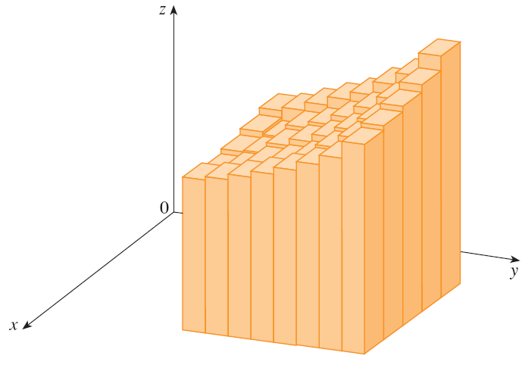
Thus, we get an approximation to the total volume of S:

Slide 31
VOLUMES
This double sum means that:
For each subrectangle, we evaluate f at the chosen point and multiply by the area of the subrectangle.
Then, we add the results.

Slide 32
VOLUMES
Equation 4
Our intuition tells us that the approximation given in Equation 3 becomes better as m and n become larger.
So, we would expect that:

Slide 33
VOLUMES
We use the expression in Equation 4 to define the volume of the solid S that lies under the graph of f and above the rectangle R.
It can be shown that this definition is consistent with our formula for volume in Section 6.2

Slide 34
VOLUMES
Limits of the type that appear in Equation 4 occur frequently—not just in finding volumes but in a variety of other situations as well—even when f is not a positive function.
So, we make the following definition.

Slide 35
DOUBLE INTEGRAL
Definition 5
The double integral of f over the rectangle R is:
if this limit exists.

Slide 36
THANK YOU !

